Slide 1
Recommendations: MS River Sediment Diversions
Kyle Graham
Executive Director
CPRA
committed to our coast
committed to our coast

Slide 2
Implementing Diversions in the Master Plan
Mississippi Sediment Diversions
Diversion | Size | Status
Mid-Barataria Sediment Diversion | 50,000 cfs | Engineering and Design (E&D)
Mid-Breton Sediment Diversion* | 35,000 cfs | Project Planning
Lower Barataria Sediment Diversion | 50,000 cfs | Project Planning
Lower Breton Sediment Diversion | 50,000 cfs | Project Planning
Upper Breton Sediment Diversion | 250,000 cfs | Project Planning
*Mid-Breton Sediment Diversion capacity has been modified from a 5,000 cfs diversion which operated nearly year-round, to a 35,000 cfs diversion which is pulsed during peak flood events.

Slide 3
Diversion Planning Milestones
2012 - Present
2012 – Coastal Master Plan unanimously approved
2013 – Funding made available for diversions
E&D funds for Mid Barataria approved in FY14 Annual Plan
DWH criminal settlement directs $1.272B to NFWF for barrier islands and diversions in LA.
– Solicitation of views initiated for Mid Barataria
– Diversion Expert Advisory Panel established
– NFWF funds obligated for LMR sediment diversion planning
2014 – Suite of diversion studies underway
2015 – CPRA recommendation to advance
Notes:
Solicitation of views letters proactively sent out by CPRA in May 2013
Expert panel established Sept 2013
NWFW obligates planning funds for lowers Nov 2013

Slide 4
Addressing Stakeholder Concerns
Is there enough sediment in the river?
How long will it take to build land?
Will there be impacts on navigation?
Will there be flooding / increased water levels?
Can storm surge risk be reduced?
How will fisheries be impacted (displacement, fisheries kills, loss of livelihoods)?
How will nutrients / invasive species be affected?
Is dredging more efficient than diversions?
Operations?

Slide 5
Key Considerations
Decision Driver | Metrics | Evaluation
Land | Wetland Acres | Land built and/or maintained
River | Water levels, velocity, sediment transport | Flood protection, navigation, freshwater supply
Communities | Flood risk reduction, jobs, economic trends by sector, ecosystem services | Vulnerability, cohesion, resilience
Habitat | Salinity, vegetation, and water quality | Quality and diversity
Fish | Biomass by species and location | Abundance and distribution
Other Factors | -- | Cost, funding availability, short term vs. long term effects, public acceptance

Slide 6
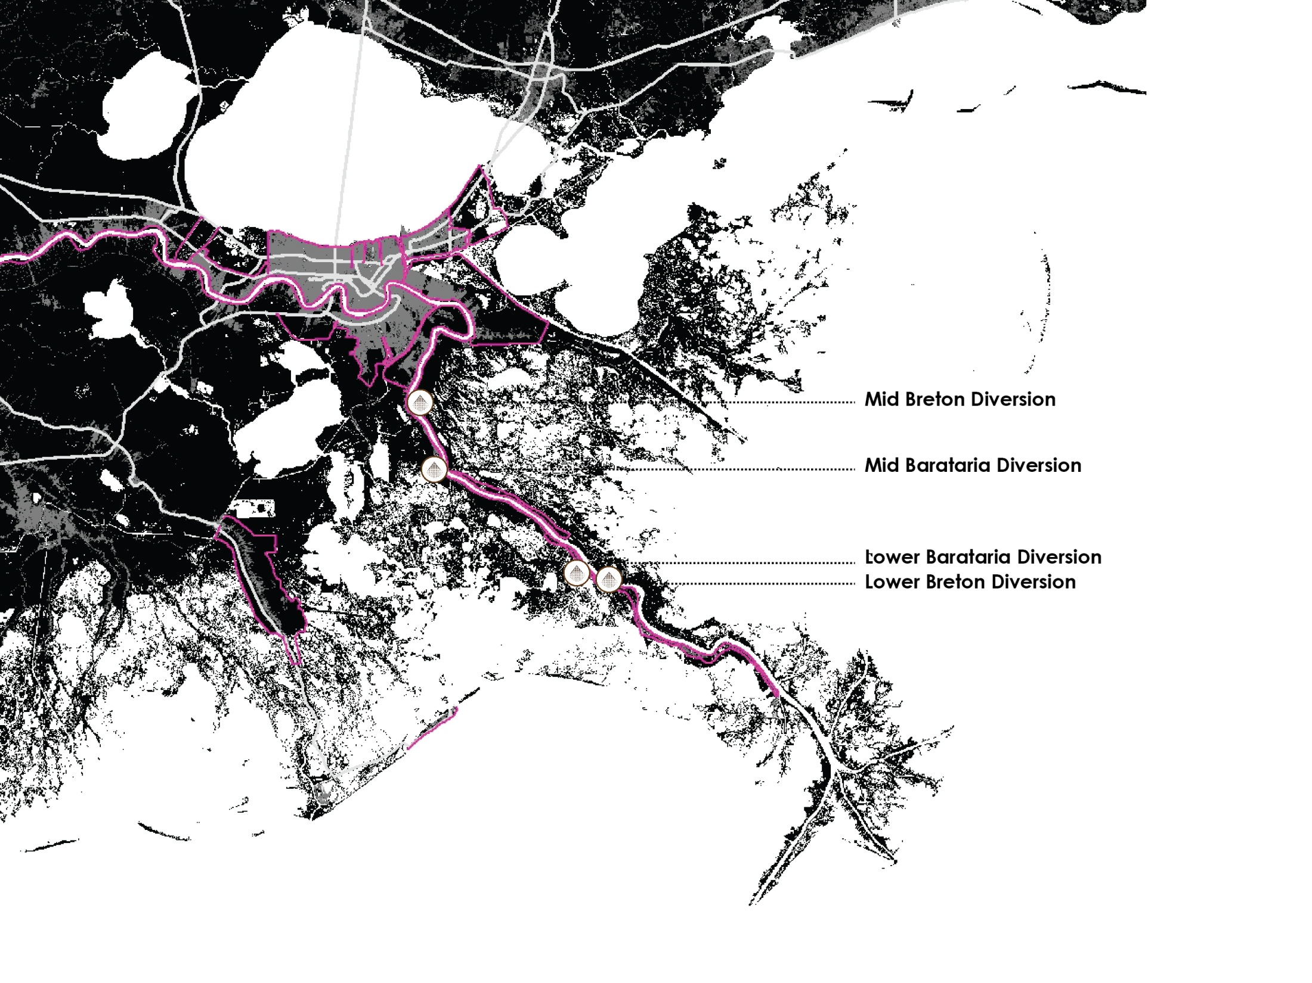
Mississippi River Sediment Diversions

Slide 7
Model Hydrographs

Slide 8
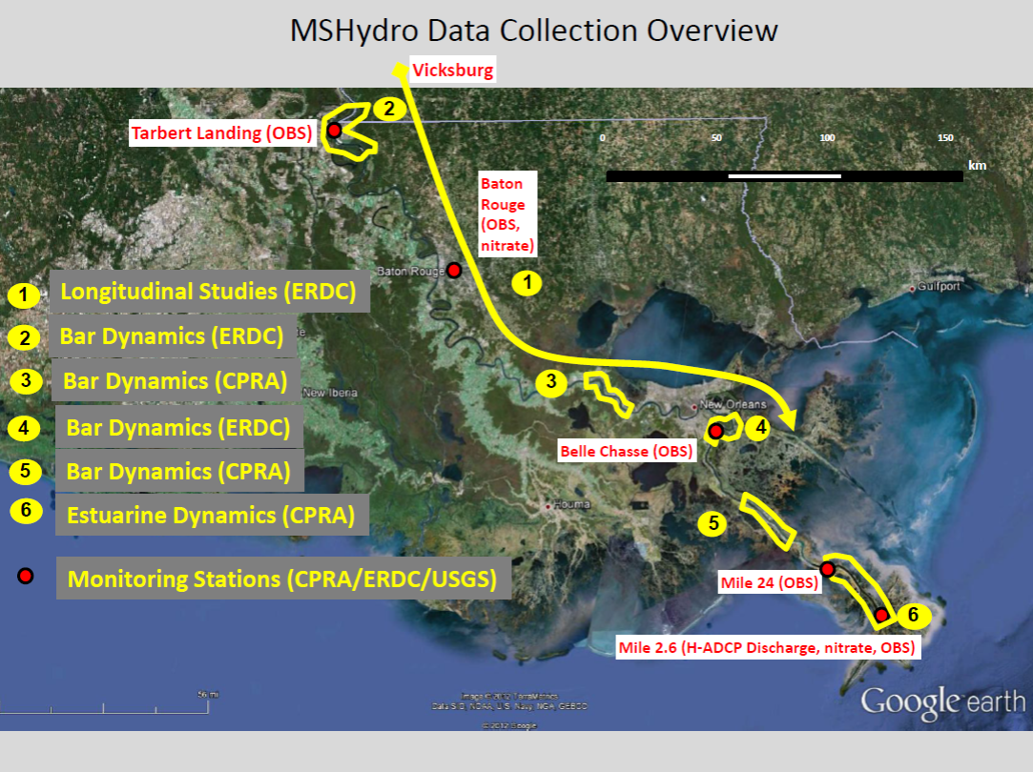
Sediment in the River
MS River Hydrodynamic and Delta Management Study
Data collection by the state and Corps for the MRHDM study has informed sediment loads used in modeling efforts since the 2012 Master Plan

Slide 9
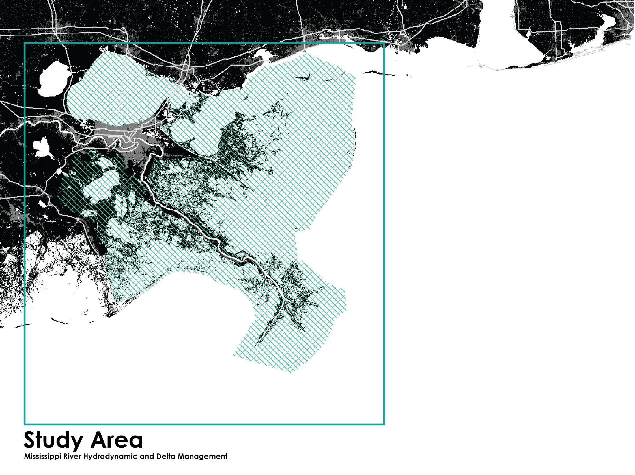

Slide 10
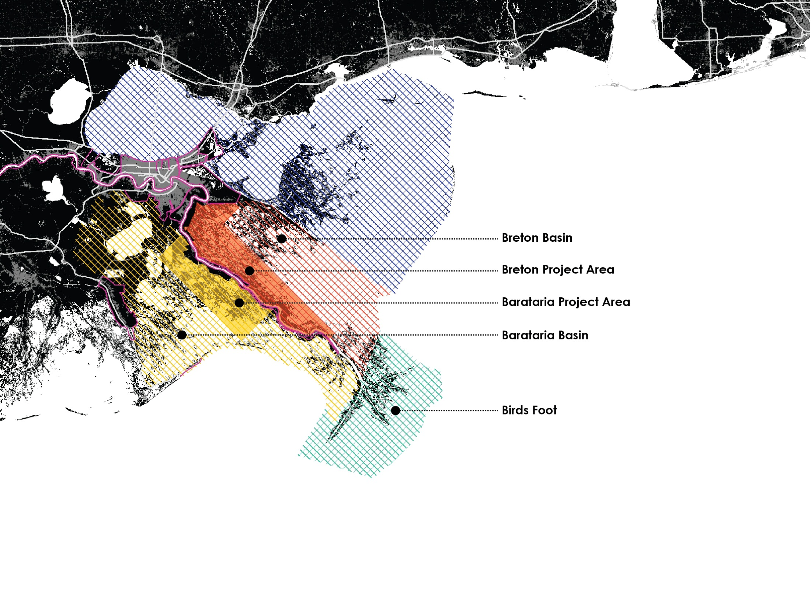

Slide 11
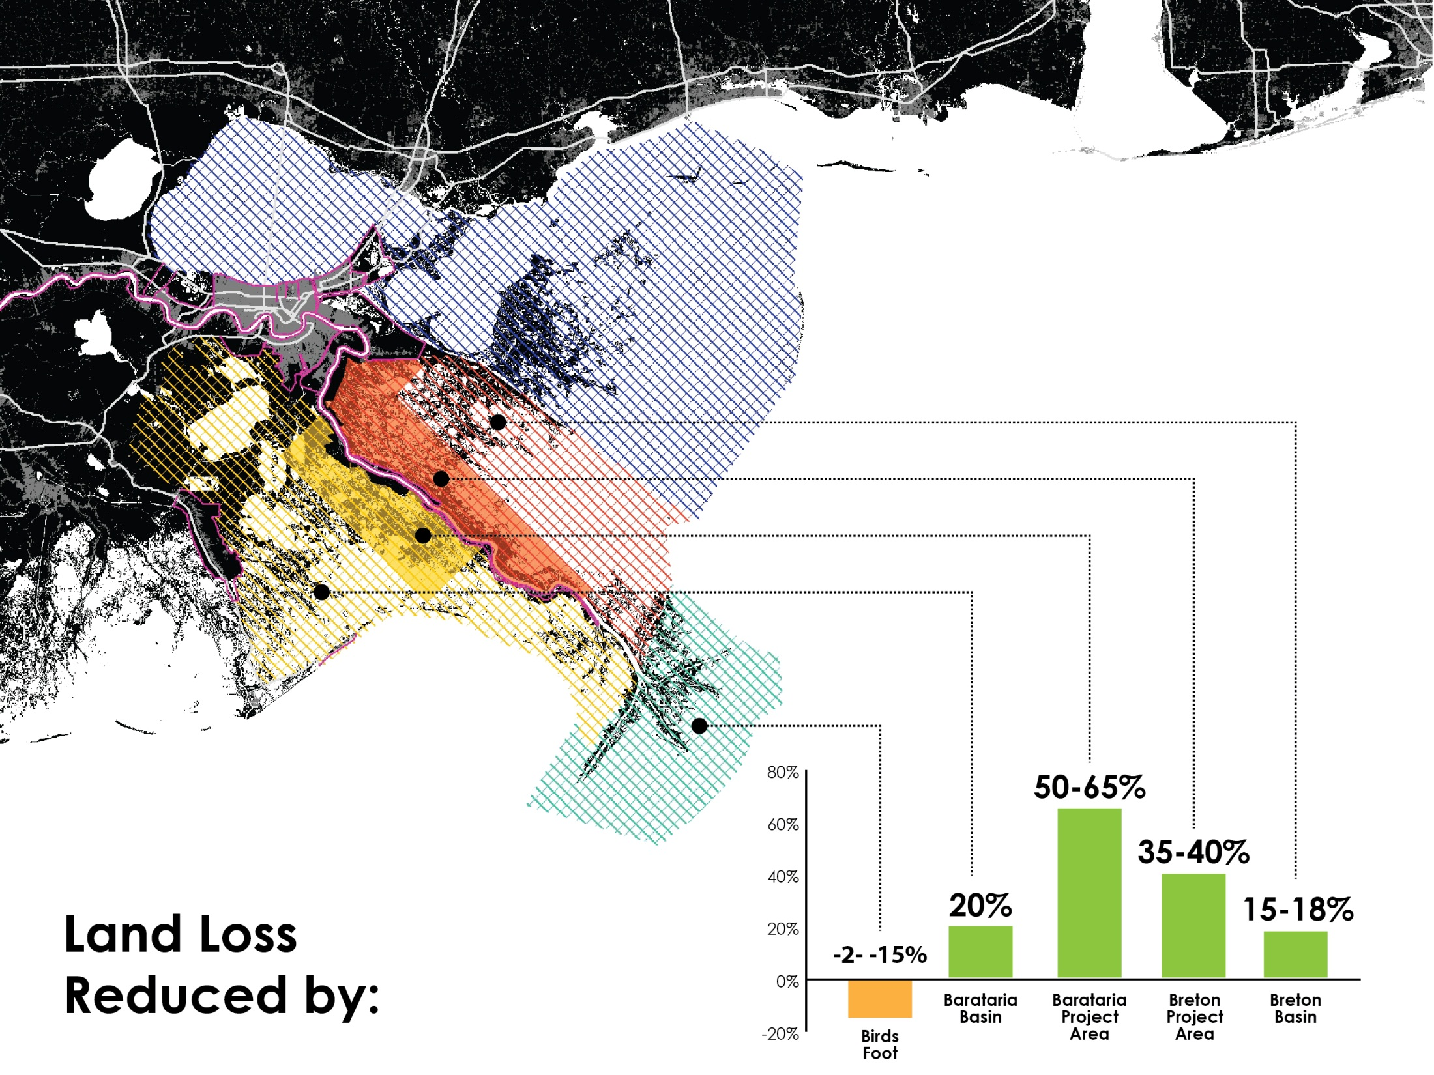

Slide 12
Net Acres Built or Sustained At Year 50
Diversion | MRDM Delft (Project Area) | 2012 Master Plan
Mid-Barataria | 24,200 | 32,200
Mid-Breton | 16,100 | 14,100
Lower Barataria | 5,400 | 13,100
Lower Breton | 1,400 | 11,700
Notes:
mid-Barataria (1st increment) was run at 50,000 cfs for the 2012 MP and at 75,000 cfs for MRDM Delft runs
mid-Breton was run at 5,000 cfs for the 2012 MP and at 35,000 for the MRDM runs
2012 MP numbers are from project fact sheets (moderate environmental scenario)
This is not really an apples to apples comparison: The Delft runs and 2012 MP runs used different models with different grid resolution and applied different operation strategies and different assumptions regarding the river hydrograph and other boundary conditions.

Slide 13
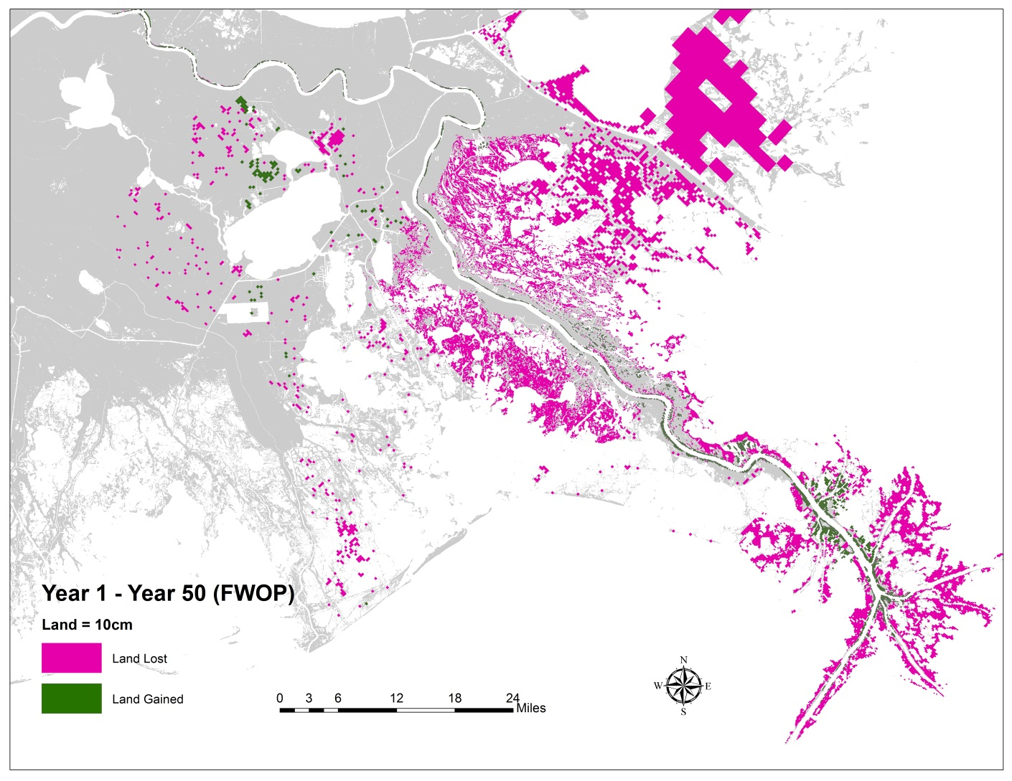
Land Change
Future Without Project (Year 50)

Slide 14
Land Change
Future with 4 Diversions
(Year 50)

Slide 15
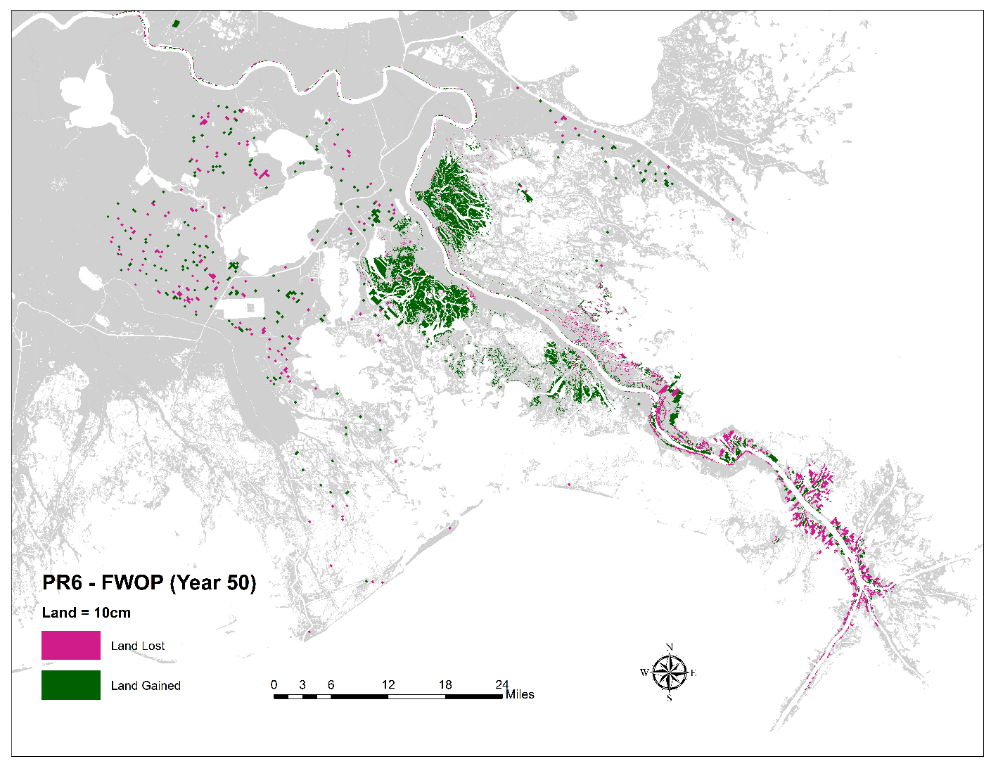
Land Change
Difference between 4 Diversions vs. FWOP
(Year 50)

Slide 16
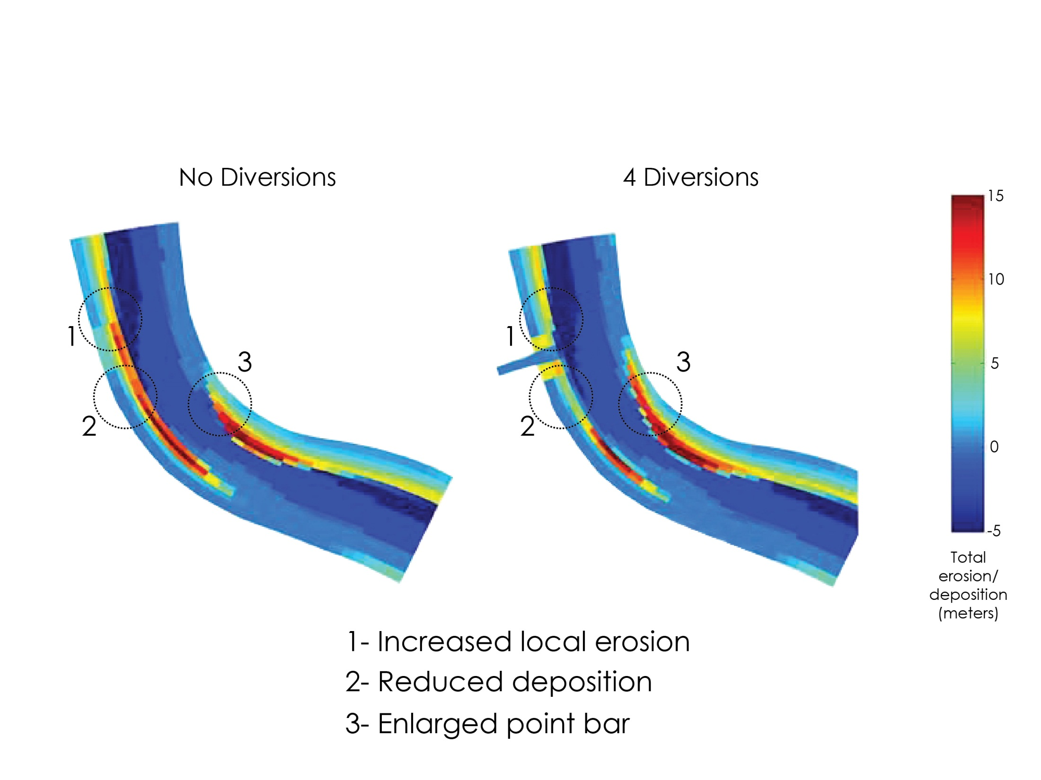
River Effects Mid Barataria
Notes:
Cumulative erosion/deposition (m)
We are using the Delta Management models as well as models developed under MS River Hydro Study to look at river side effects, including shoaling and channel maintenance.
The results of the latest runs are still forthcoming.
The model shows bars growing up- and down-stream, but not into the navigation channel. The authorized width of the channel is not encroached on (We will work to get specific #s for this)
Once the analysis of model results makes a little more progress, we will be able to look at any changes in depth at anchorages.
There is a reduction in sand reaching Head of Passes. We have a work plan to look at what happens to fine sediments.
With all 4 diversions operating, peak river stage at Bonnet Carre drops 1.7’. Potential to relieve stress on flood protection system.

Slide 17
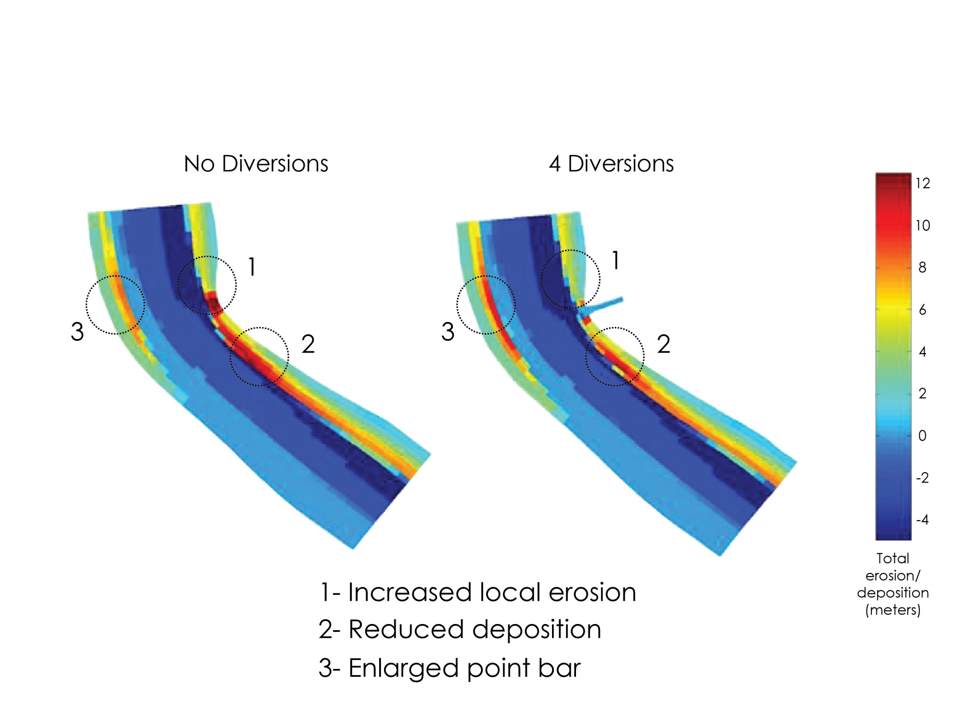
River Effects Mid Breton
Notes:
We are using the Delta Management models as well as models developed under MS River Hydro Study to look at river side effects, including shoaling and channel maintenance.
The results of the latest runs are still forthcoming.
The model shows bars growing up- and down-stream, but not into the navigation channel. The authorized width of the channel is not encroached on (We will work to get specific #s for this)
Once the analysis of model results makes a little more progress, we will be able to look at any changes in depth at anchorages.
There is a reduction in sand reaching Head of Passes. We have a work plan to look at what happens to fine sediments.
With all 4 diversions operating, peak river stage at Bonnet Carre drops 1.7’. Potential to relieve stress on flood protection system.

Slide 18
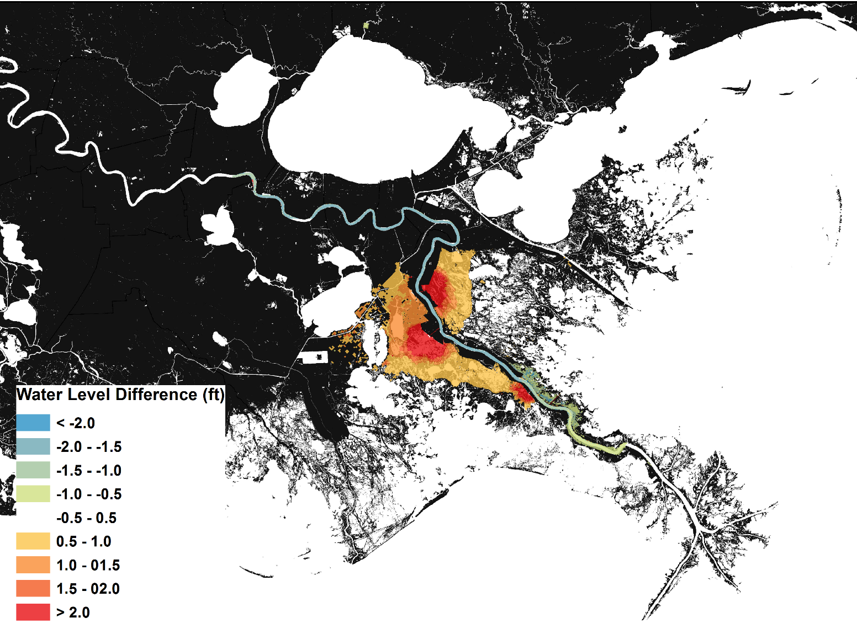
Water Level
Difference between maximum levels for 4 Diversions vs. FWOP
(Year 50)
Notes:
This map shows difference of maximum values (instantaneous max during Year 50)

Slide 19
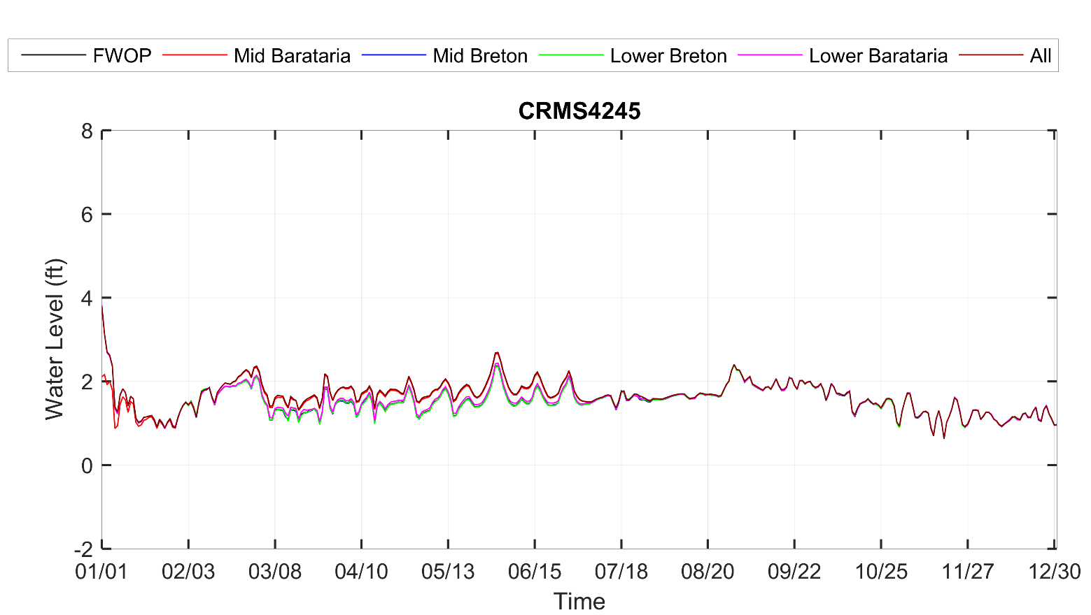
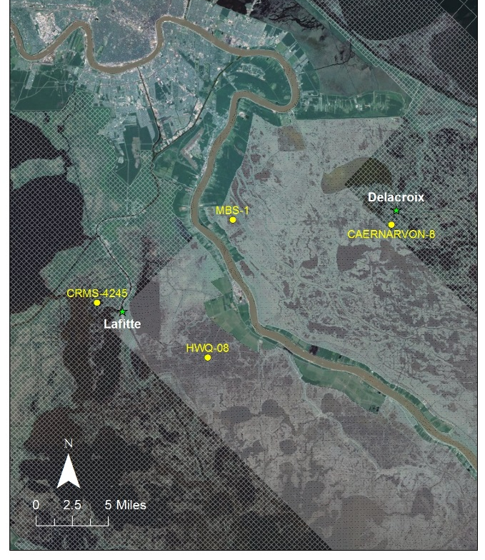
Water Level Near Lafitte, Year 50

Slide 20
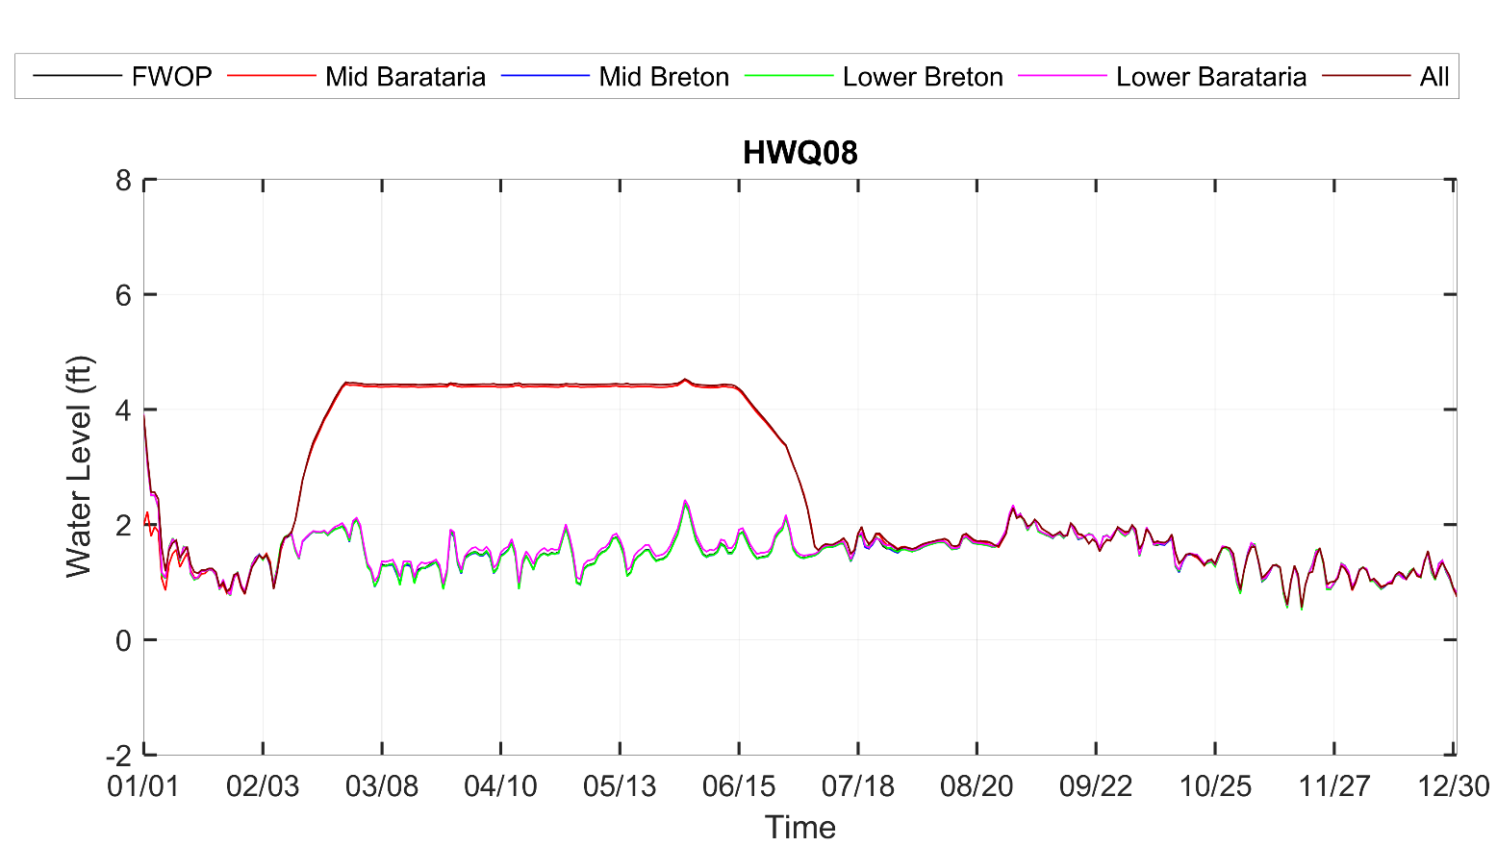
Water Level Mid Barataria Outfall Area, Year 50

Slide 21
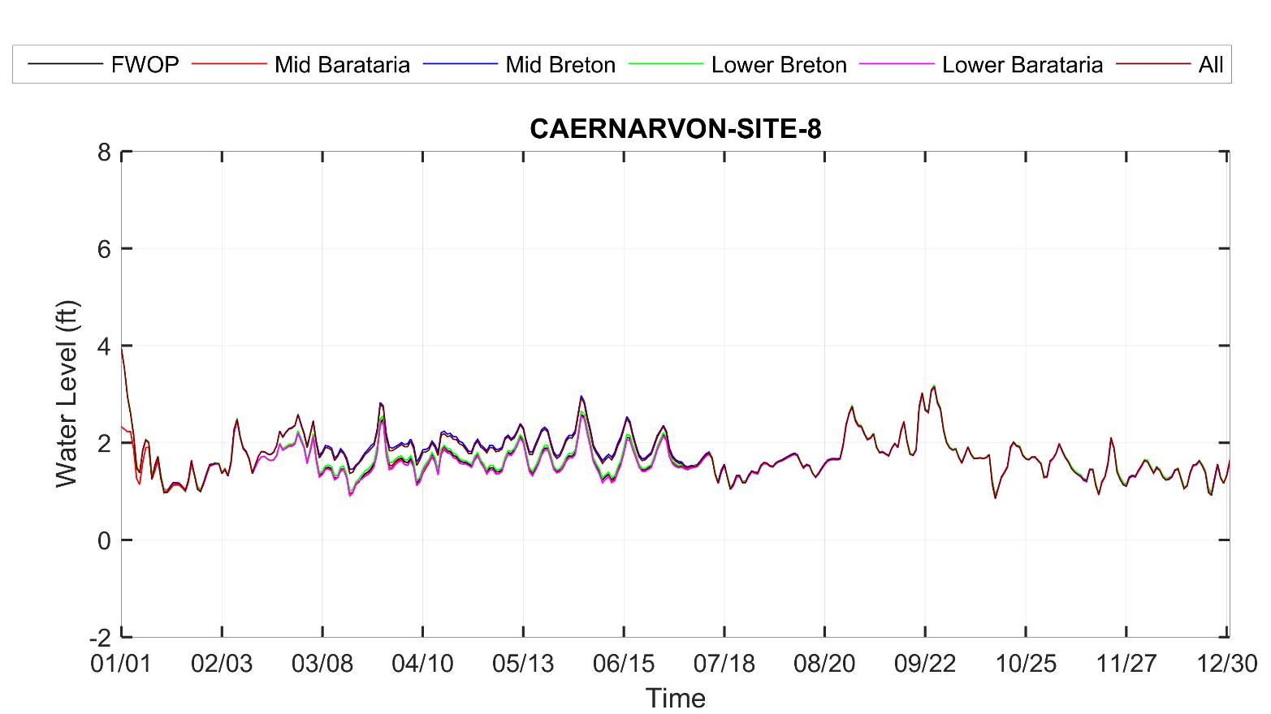
Water Level Near Delacroix, Year 50

Slide 22
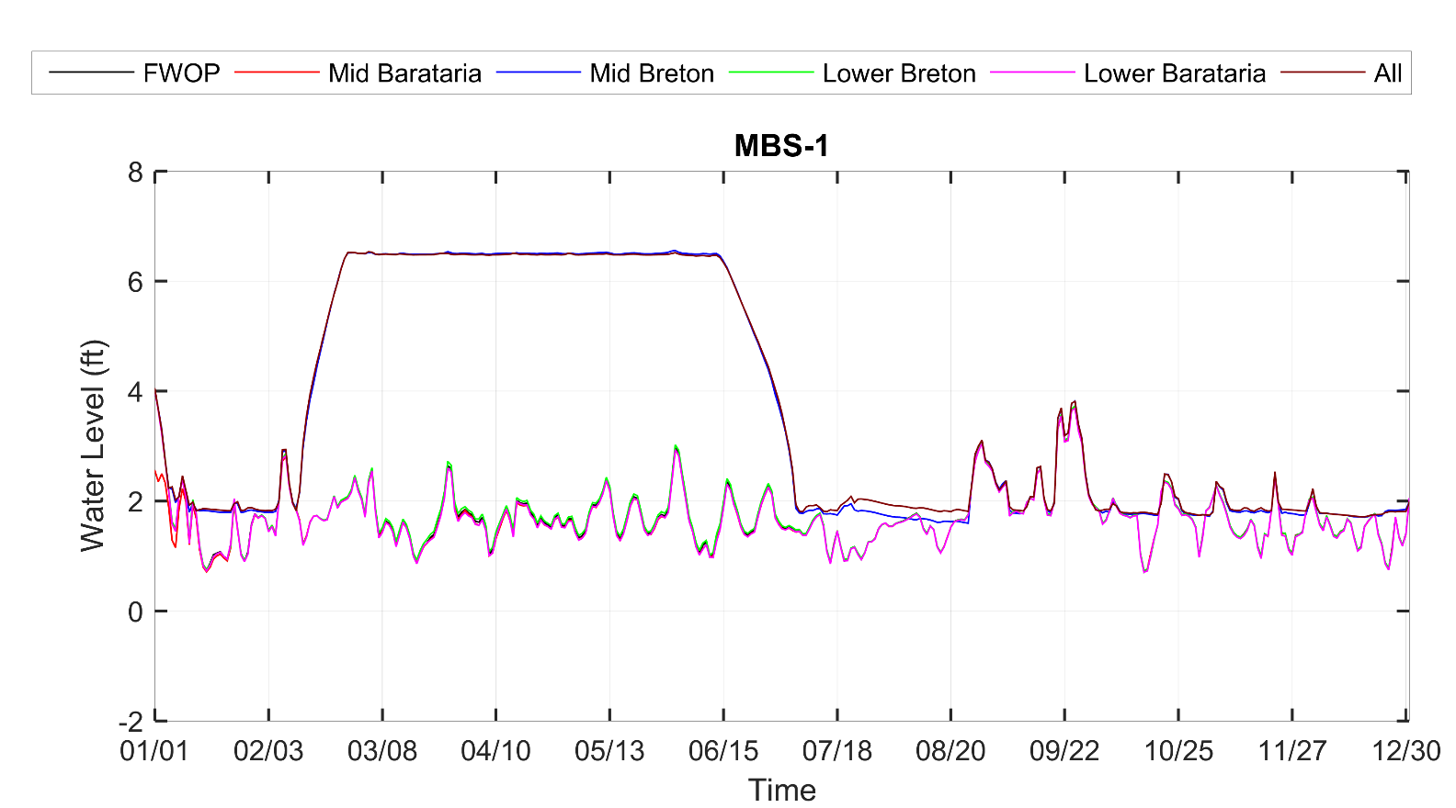
Water Level Mid Breton Outfall Area, Year 50

Slide 23
Salinity – Year 50
Future Without Project
4 Diversions

Slide 24
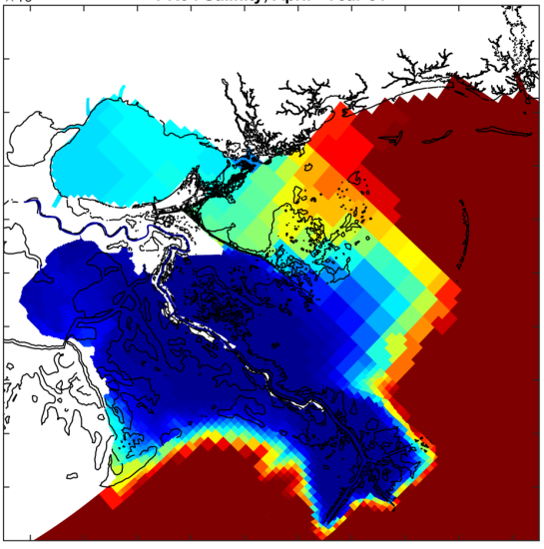
Salinity – Active (Spring)
Future Without Project
(Year 50)
4 Diversions
(Year 50)

Slide 25
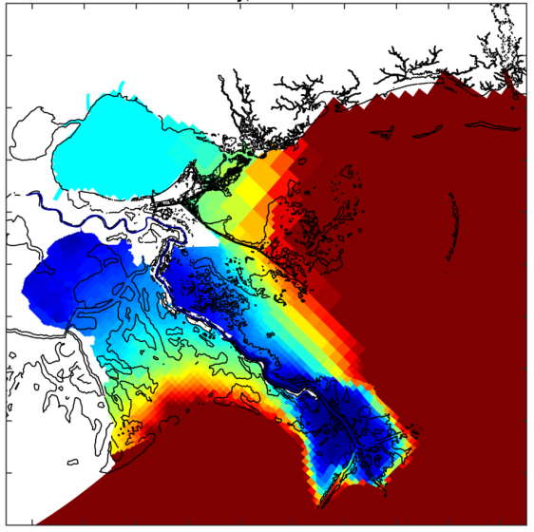
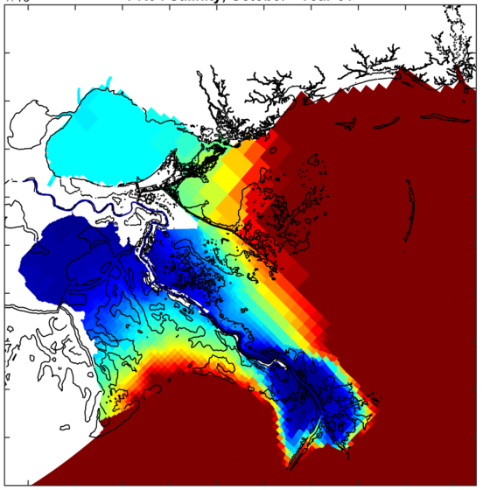
Salinity – Inactive (Fall)
Future Without Project
(Year 50)
4 Diversions
(Year 50)

Slide 26
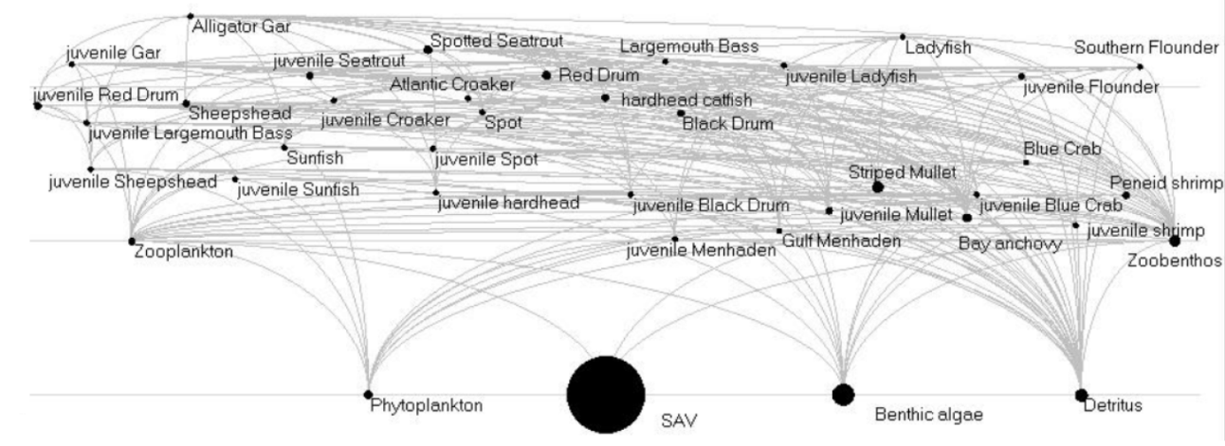
Food Webs in Community Models
Notes:
From deMutsert et al., 2012; Breton Sound Ecopath model

Slide 27
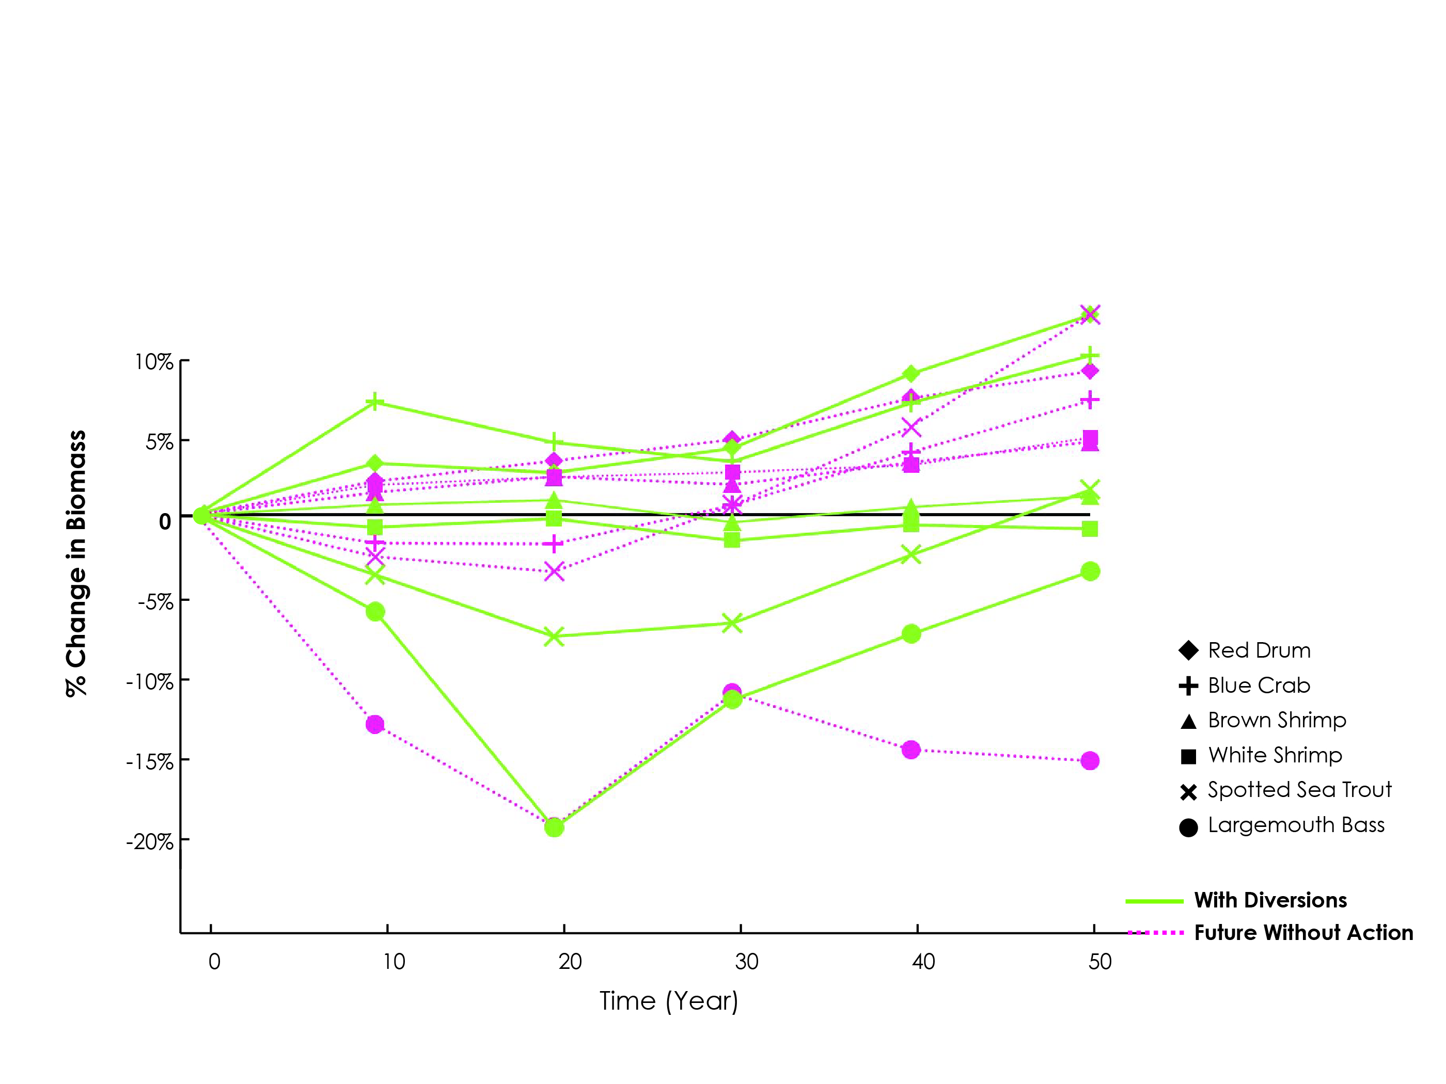
Fisheries Change from Initial Conditions (EwE)

Slide 28
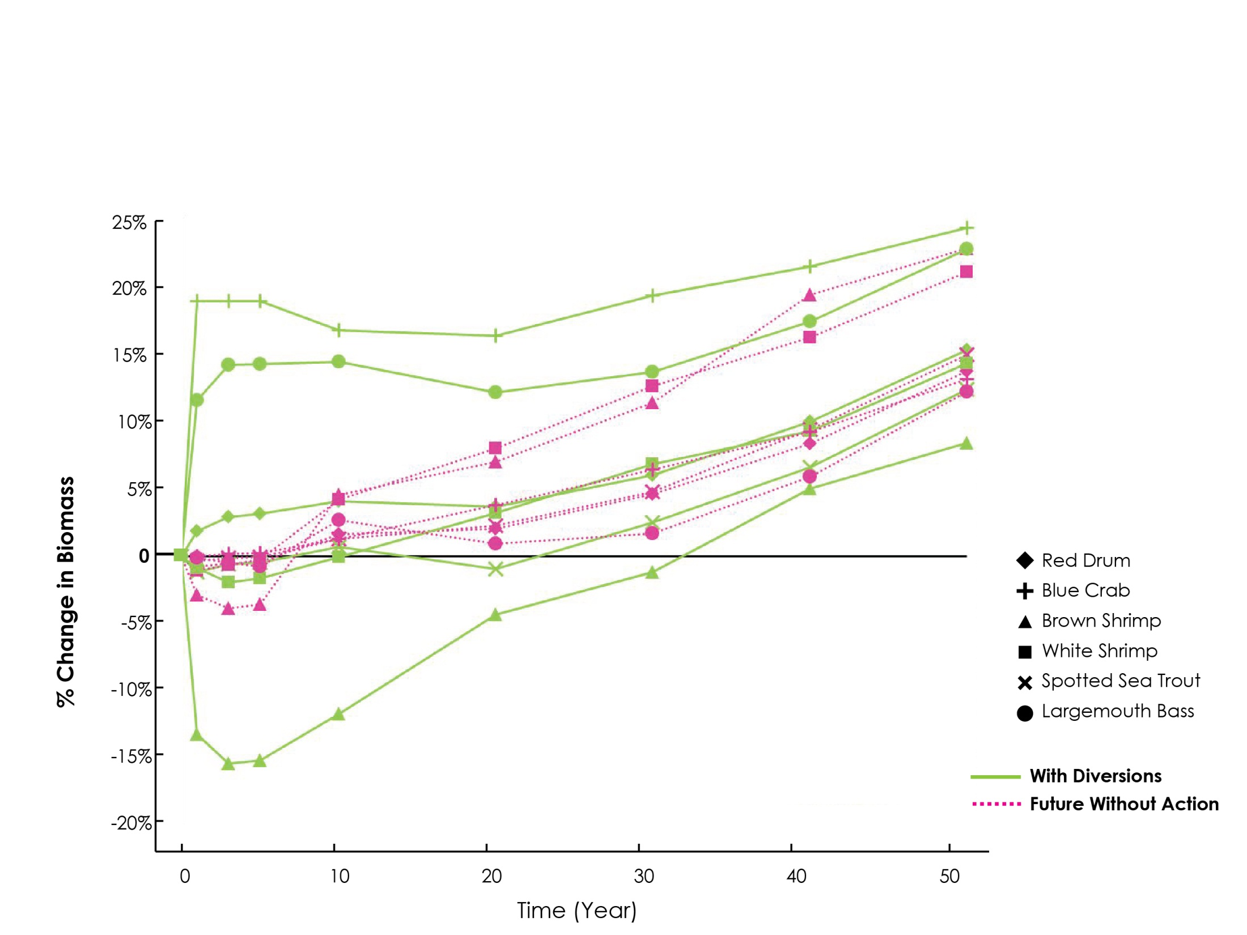
Fisheries Change from Initial Conditions (CASM)

Slide 29
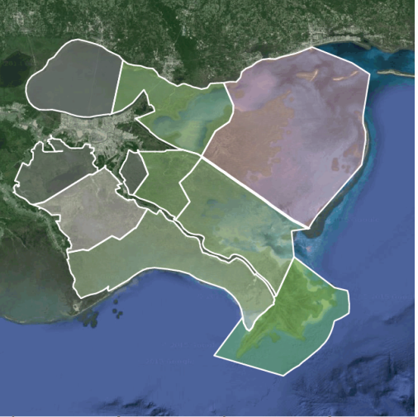
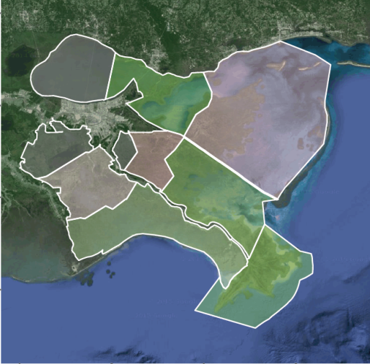
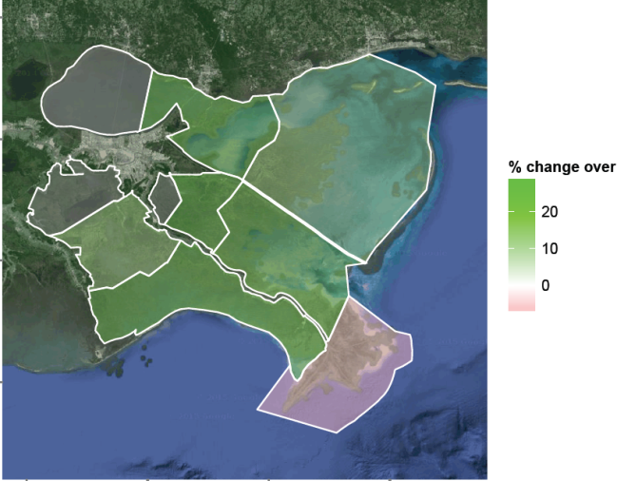
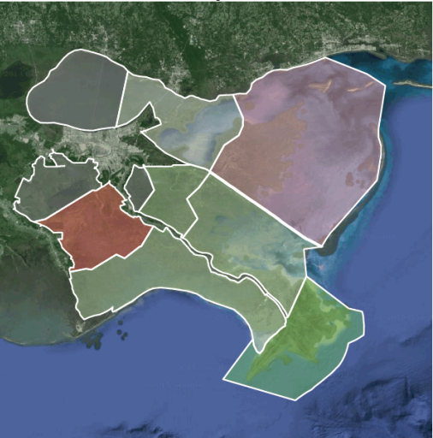
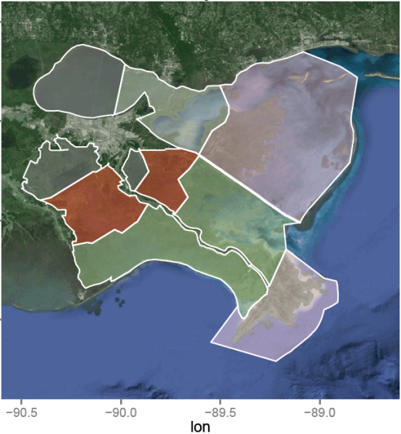
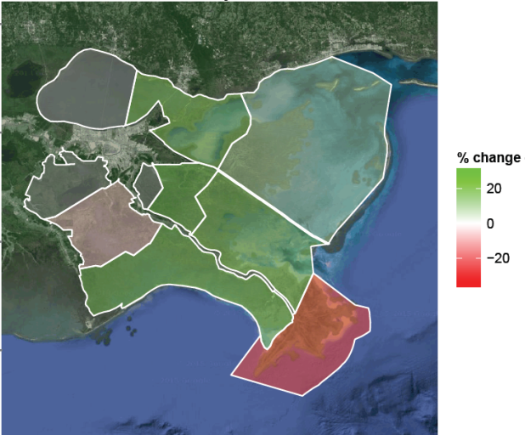
Oyster Biomass
Change from Initial Conditions
Year 10
Year 20
Year 50
Future
Without
Project
All 4
Diversions
Notes:
Oyster biomass shown spatially as an example (CASM output)

Slide 30
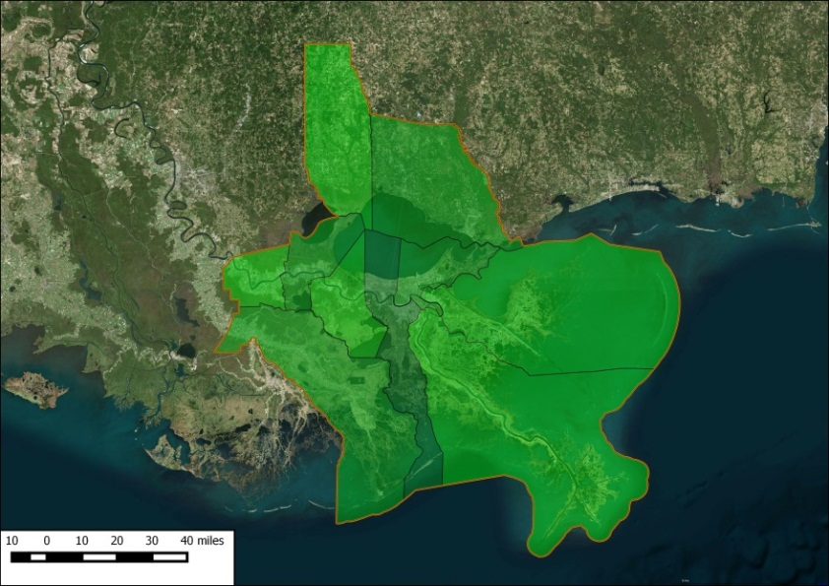
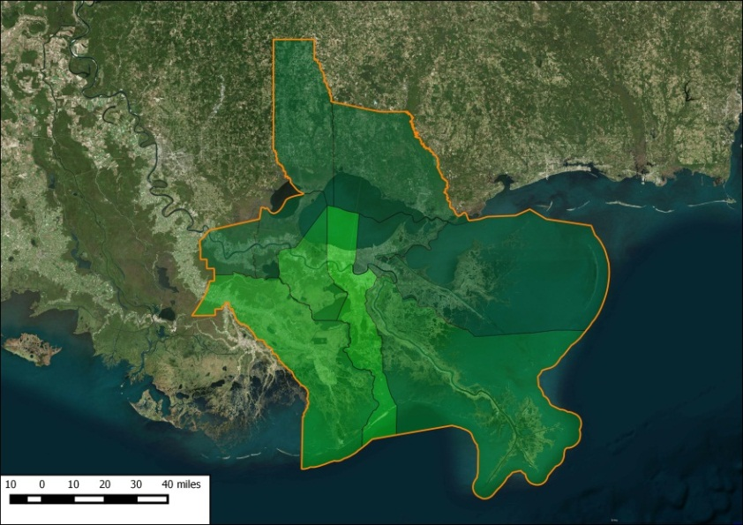
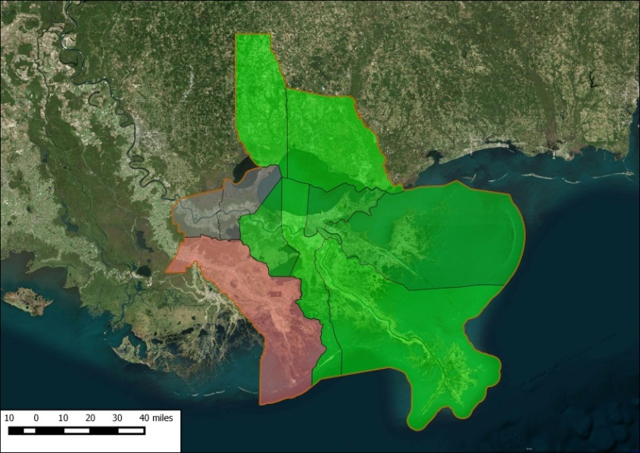
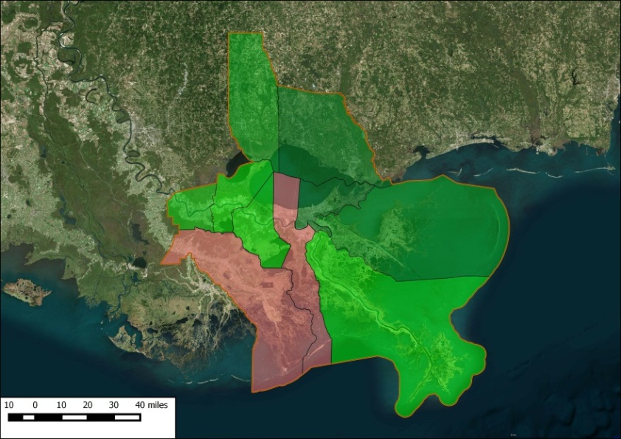
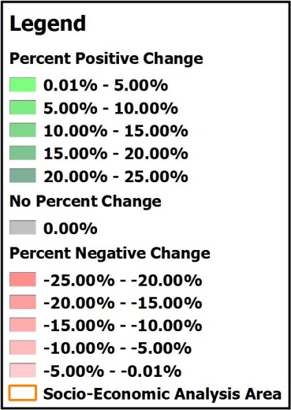
Fisher Parish Harvest 4 Diversions – Change from Initial Conditions (Year 50)
Blue Crab
Brown Shrimp
Oyster
White Shrimp

Slide 31
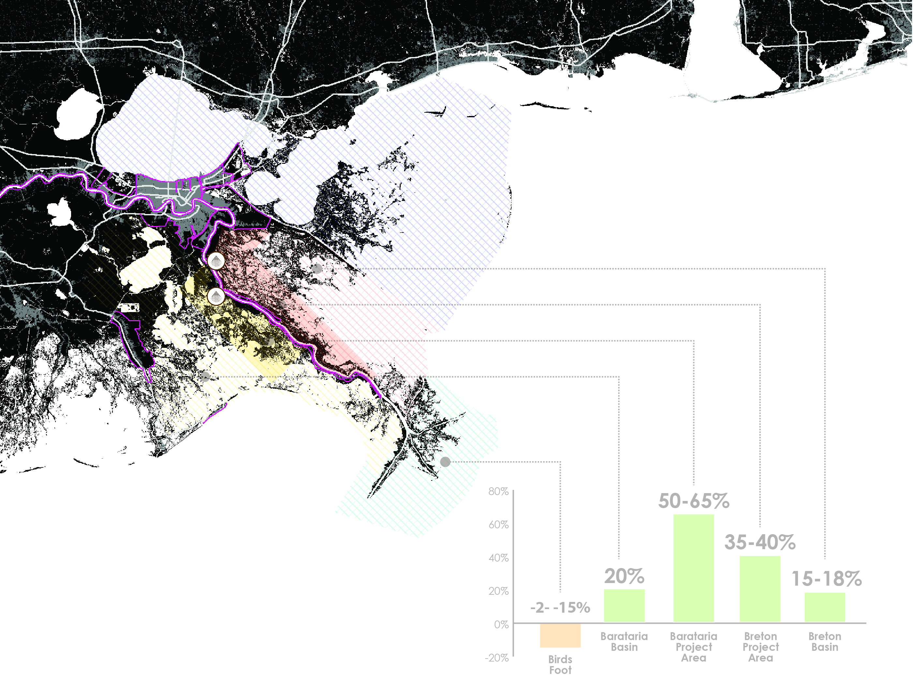
CPRA Recommendation:
Advance Mid Barataria and Mid Breton sediment diversions to engineering and design.

Slide 32
Next Steps
Immediate:
Additional public outreach – approximately 20 key briefings
FY17 Annual Plan
Intermediate:
Model Mid Barataria and Mid Breton diversions together
Continue to refine/communicate results
Publish model results; peer review
Assemble project delivery teams
Long-term:
Engineering and design
Public scoping /project-specific outreach
Operations
Adaptive management

Slide 33
WE ARE HERE

